Slide 1
Covid-19 Vaccine
Eugenics & The Great Reset

Slide 2
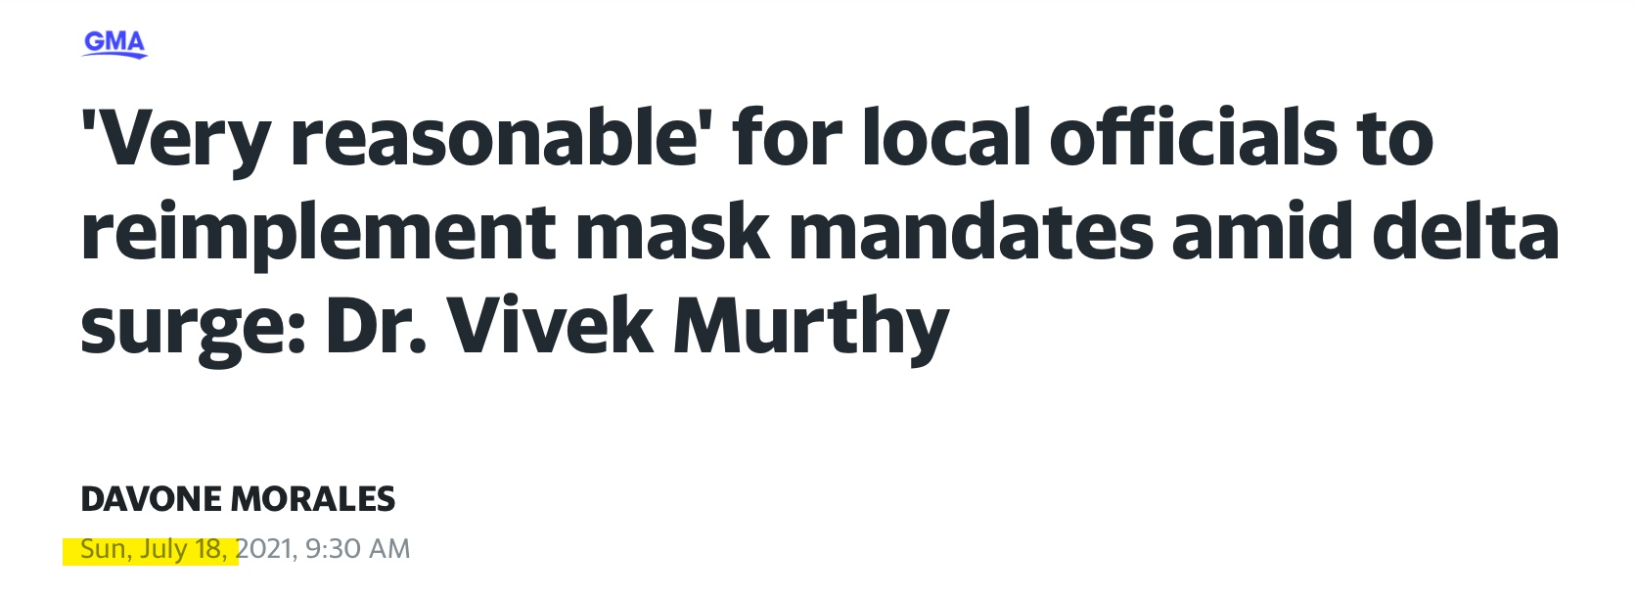

Slide 3
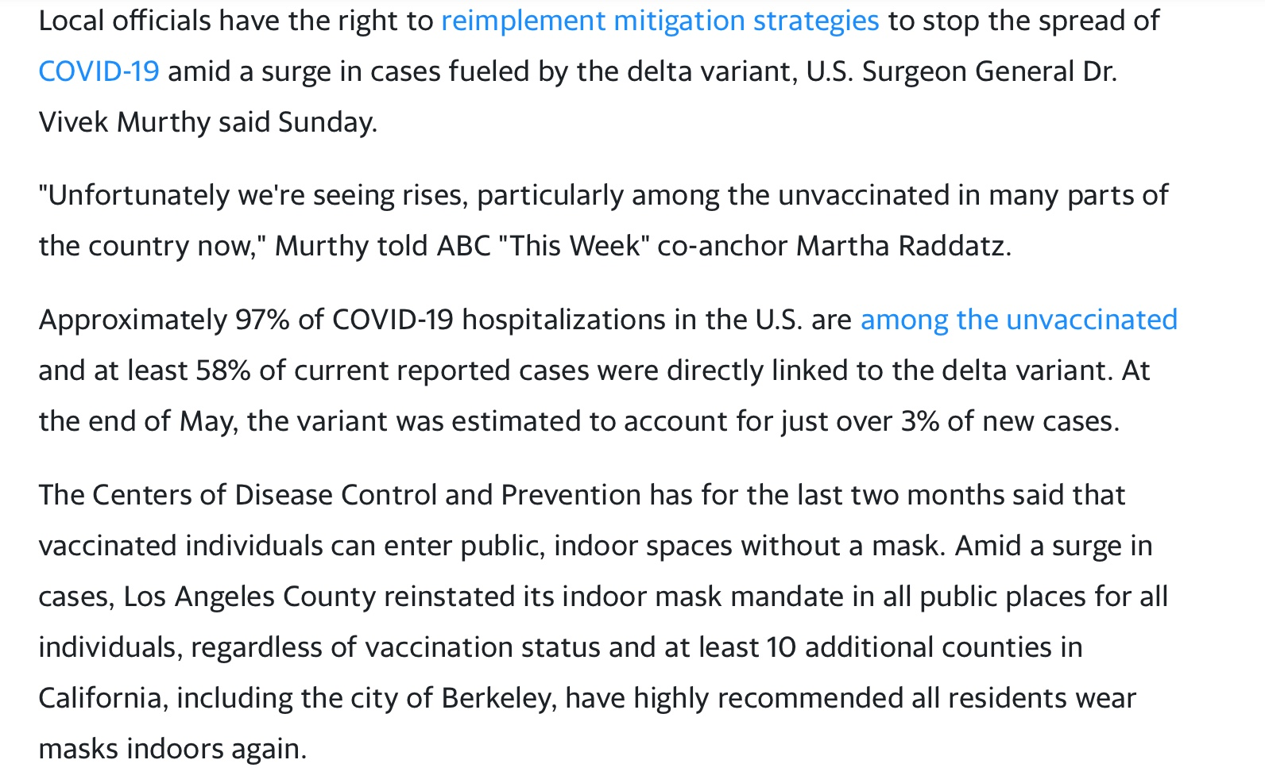

Slide 4
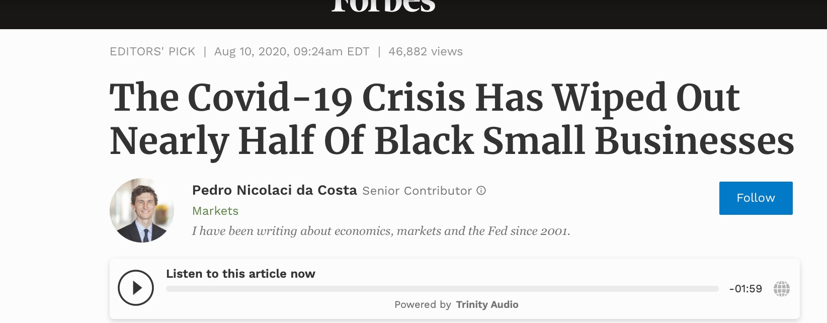

Slide 5
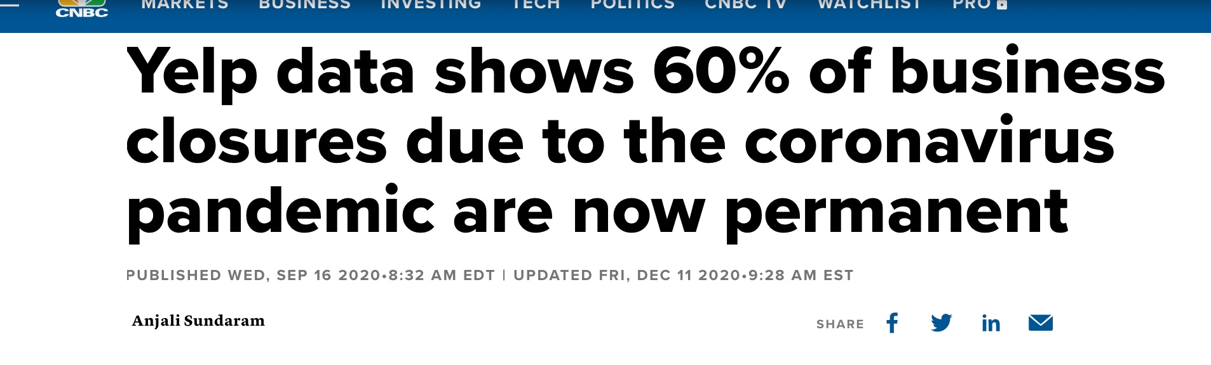

Slide 6
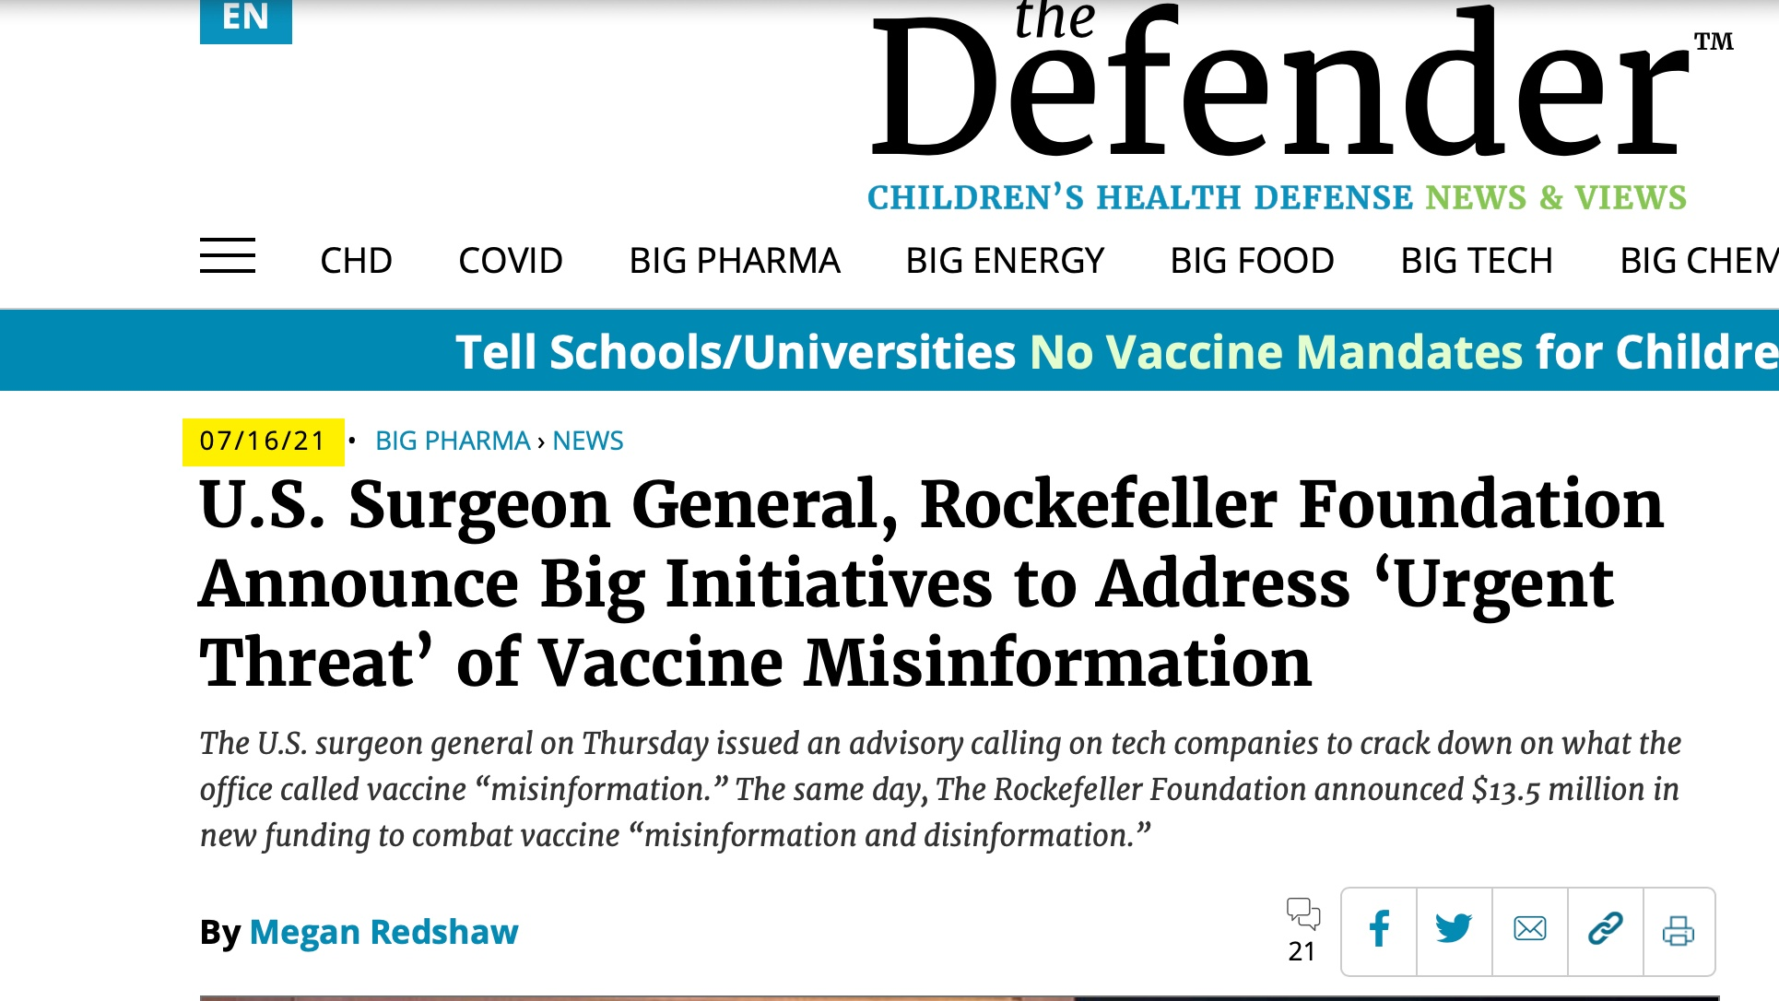

Slide 7
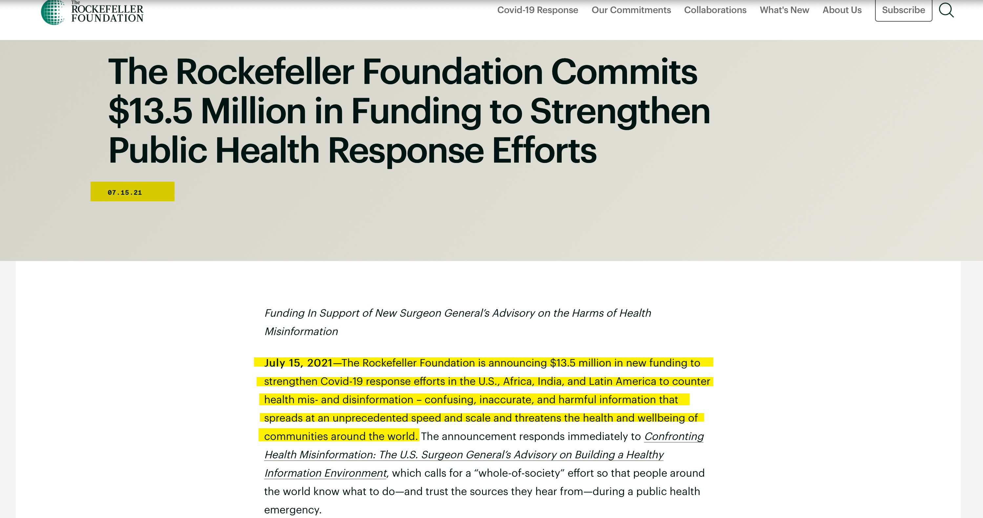

Slide 8


Slide 9


Slide 10


Slide 11
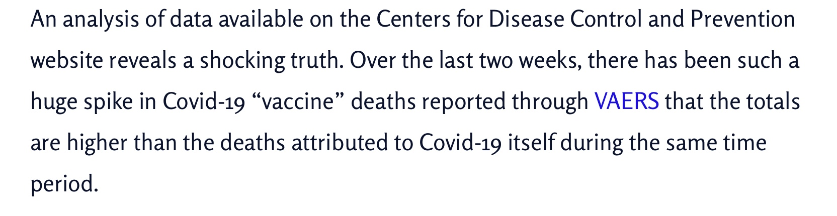

Slide 12
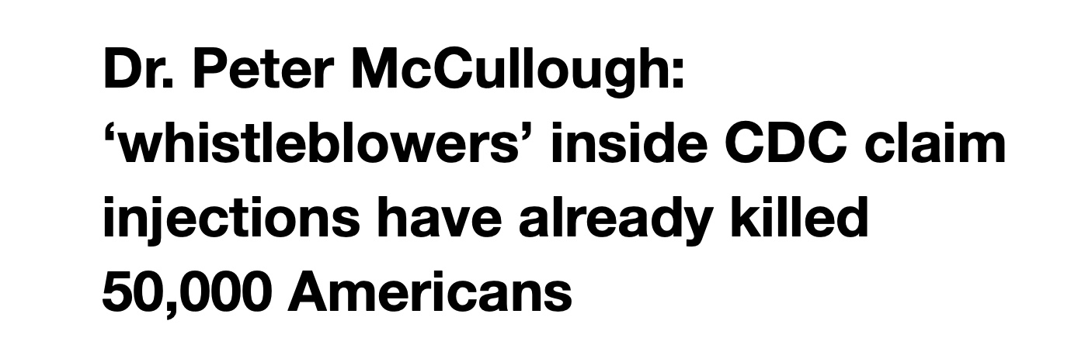

Slide 13
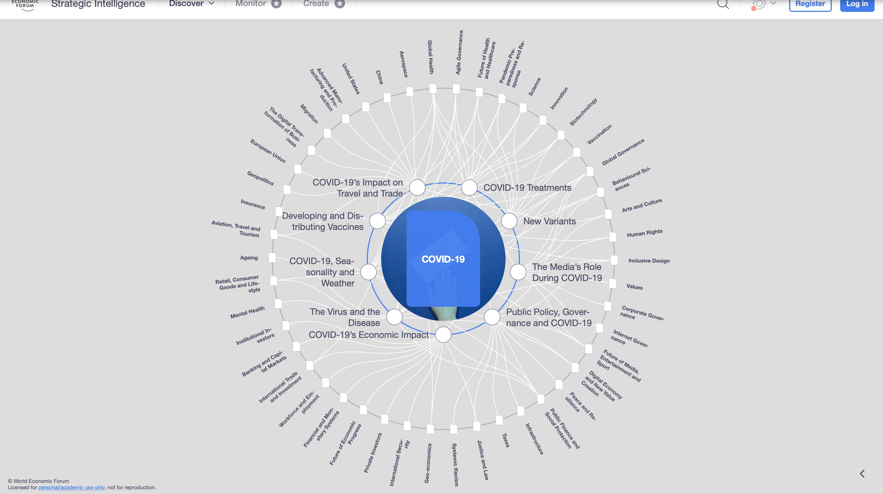

Slide 14


Slide 15
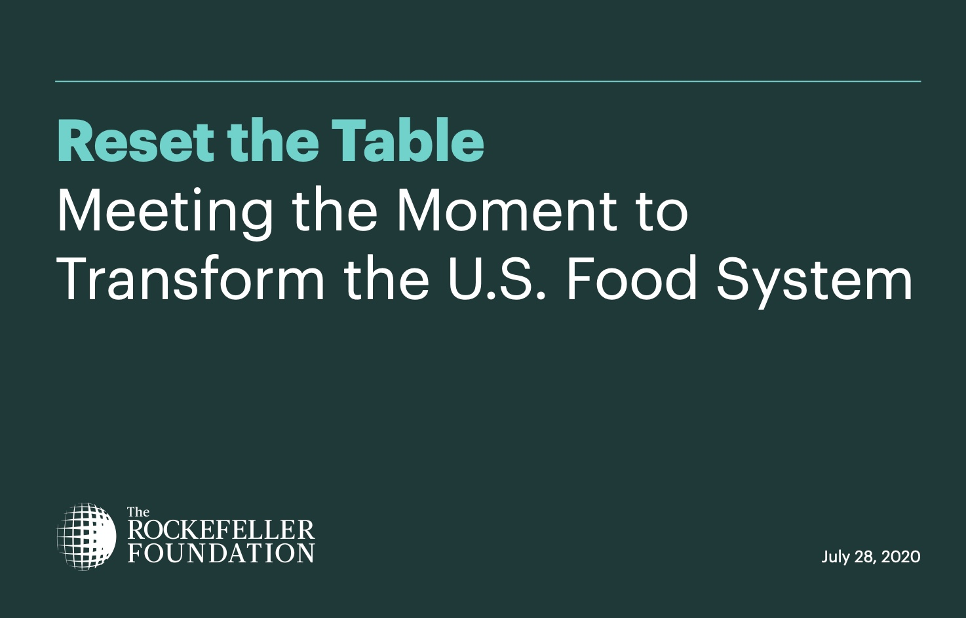

Slide 16
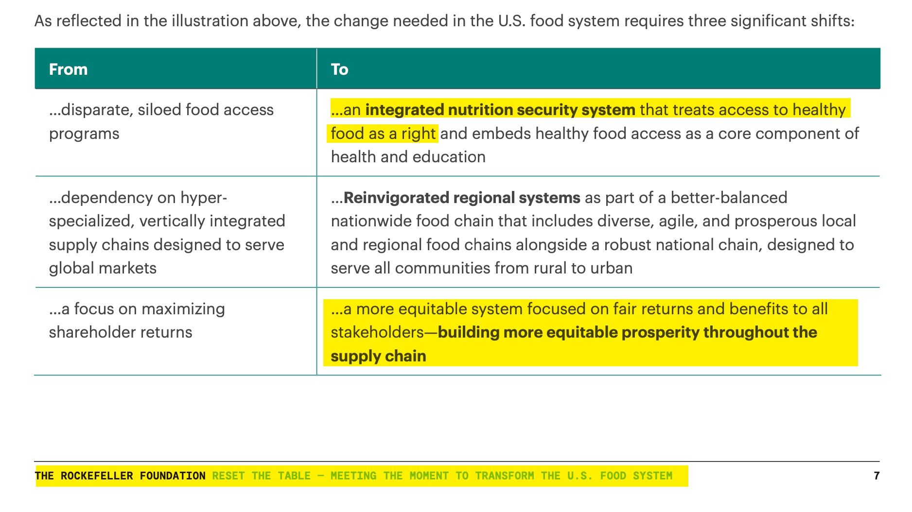

Slide 17


Slide 18


Slide 19


Slide 20


Slide 21


Slide 22


Slide 23


Slide 25


Slide 26


Slide 27
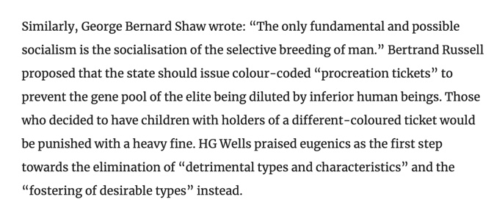

Slide 28
Covid-19 Vaccine
Eugenics & The Great Reset
Part 2

Slide 29
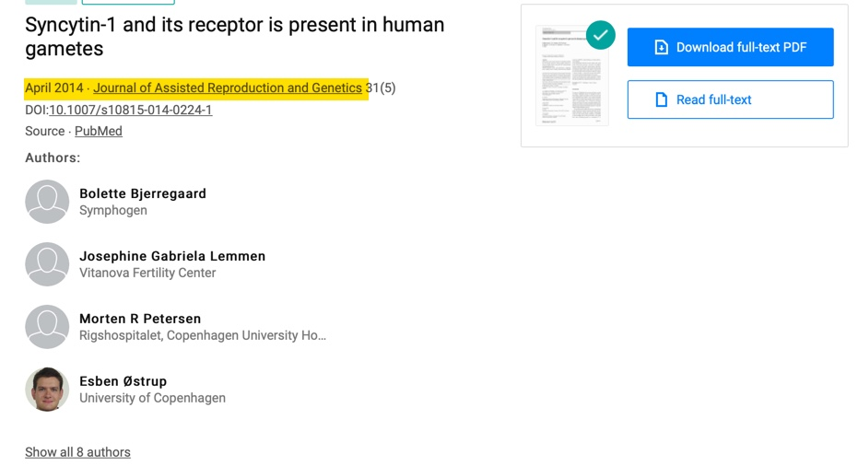

Slide 30
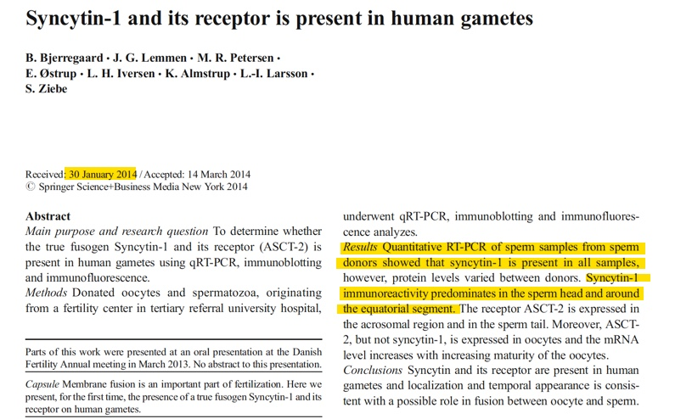

Slide 31
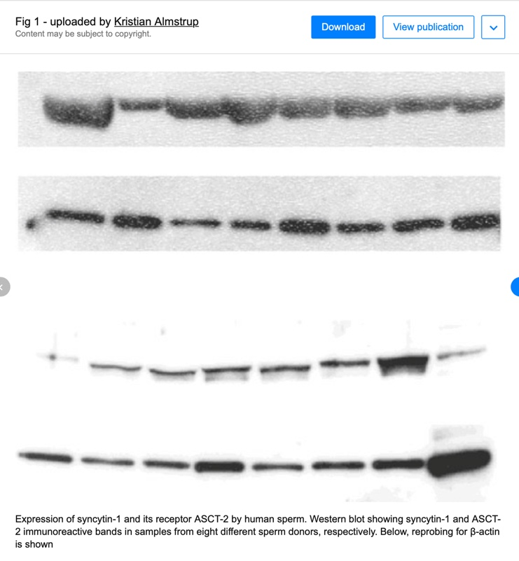

Slide 32
Fabian Socialist Julian Huxley Became the First Director General of the United Nations Educational, Science, and Cultural Organization and Authored UNESCO: Its Purpose and Its Philosophy (1948) in Which He Declared:

Slide 33
Julian Huxley:
Even though it is quite true that any radical eugenic policy will be for many years politically and psychologically impossible, it will be important for UNESCO to see that the eugenic problem is examined with the greatest care, and that the public mind is informed of the issues at stake so that much that is now unthinkable may at least become thinkable.

Slide 34
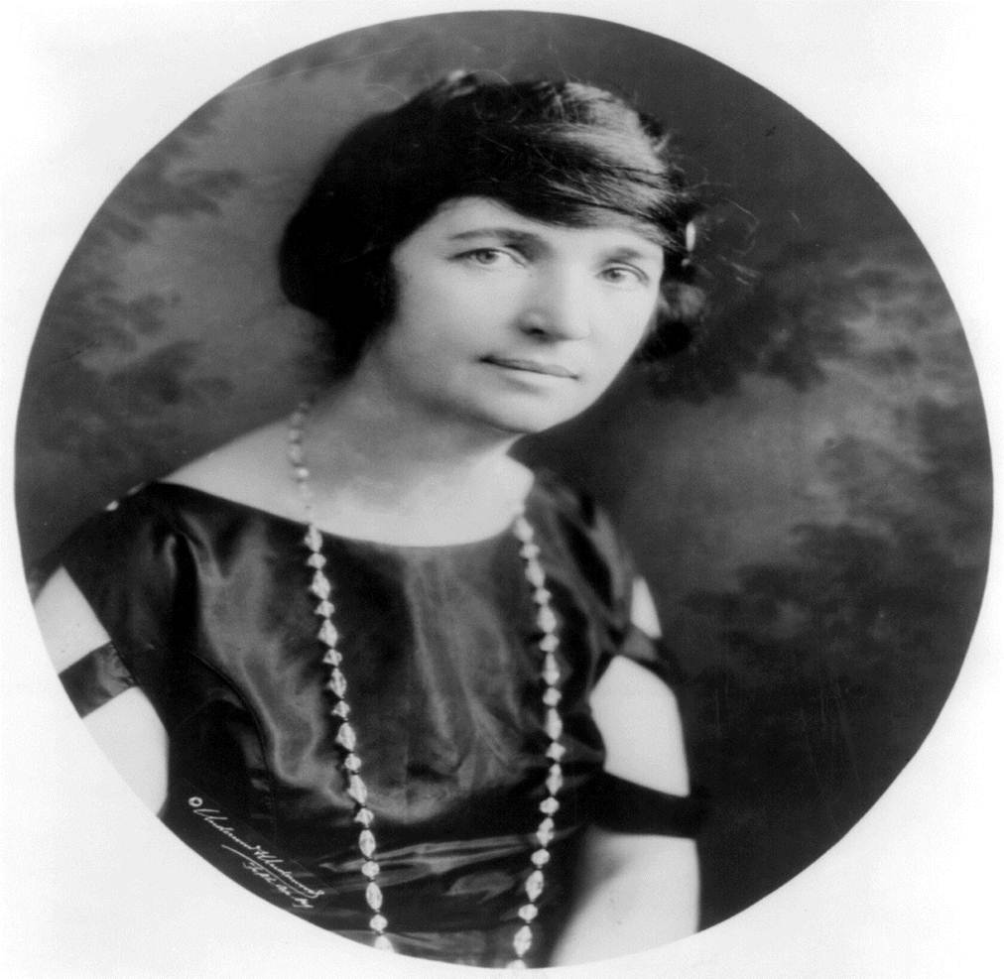
Margaret Sanger

Slide 35
To put her eugenics worldview into practice Margaret Sanger opened a birth control clinic in Brownsville, New York, an area inhabited by Slavic, Latino, Italian, and Jewish immigrants. Sanger stated that these ethnic groups were “dysgenic and diseased races” that needed to have their “reckless breeding” curbed.

Slide 36
Sanger became acquainted with the doctors and scientists who had worked with Nazi Germany’s “race purification” program and who had no compunction about the euthanasia, sterilization, abortion, and infanticide programs of the early Reich.

Slide 37
In The Pivot of Civilization, she praised the cause of eugenics, openly calling for the eradication of “human weeds,” for the “cessation of charity,” for the segregation of “morons, misfits, and the maladjusted,” and for the coercive sterilization of “genetically inferior races.”

Slide 38
In addition to her husband’s money, she received large grants from foundations such as Rockefeller, Ford, and Mellon.

Slide 39

Paul Ehrlich, in his alarmist book
Population Bomb Wrote:

Slide 40
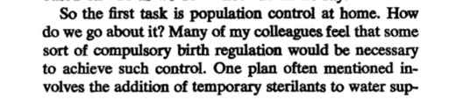
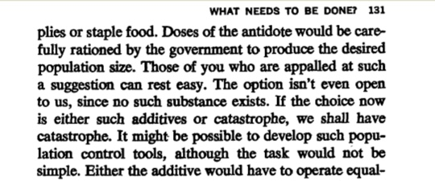
Paul Ehrlich, in his alarmist book
Population Bomb Wrote:

Slide 41
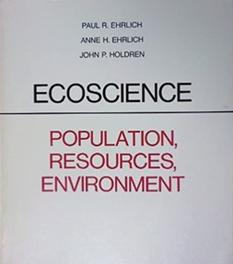
In, Ecoscience, Holdren and the Ehrlichs share their vision for population control:

Slide 42
It has been concluded that
compulsory population-control laws,
even including laws requiring compulsory abortion, could be sustained under the existing constitution if the population crisis becomes sufficiently severe to endanger society…If some individuals contribute to general social deterioration by overproducing children, and if the need is compelling, they can be required by law to exercise reproductive responsibility.

Slide 43
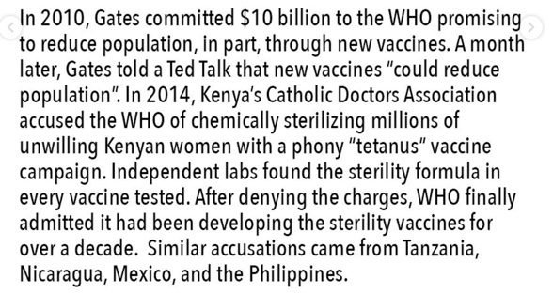
Robert F. Kennedy Jr. Instagram Page

Slide 44
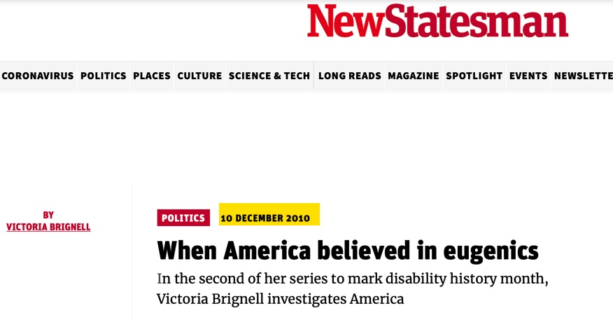

Slide 45
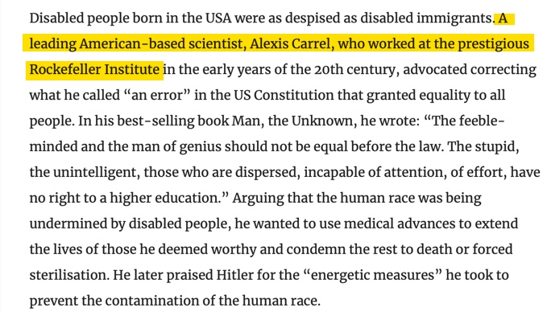

Slide 46
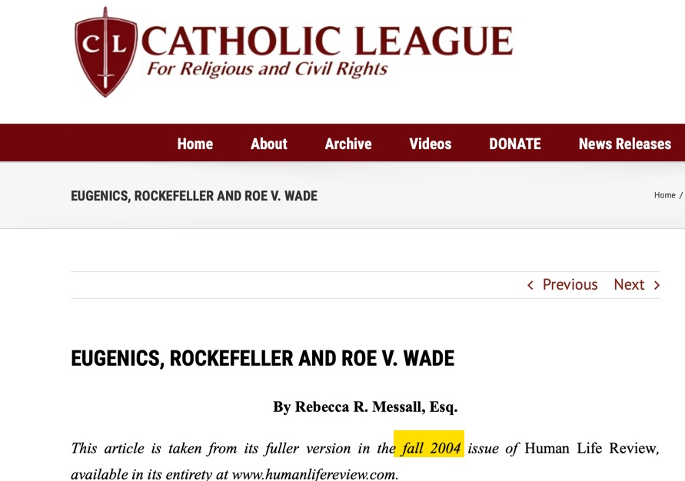

Slide 47
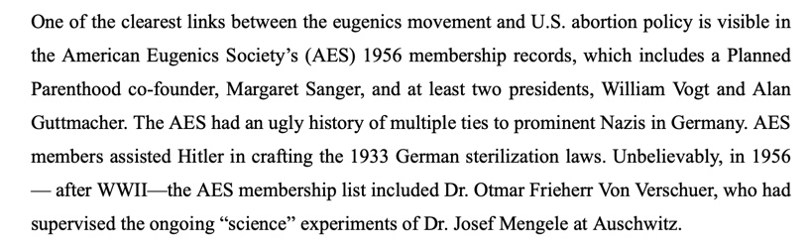

Slide 48
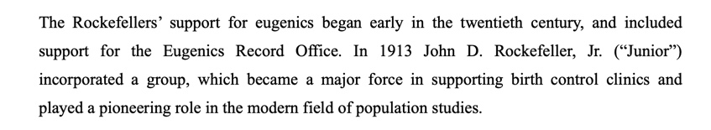

Slide 49
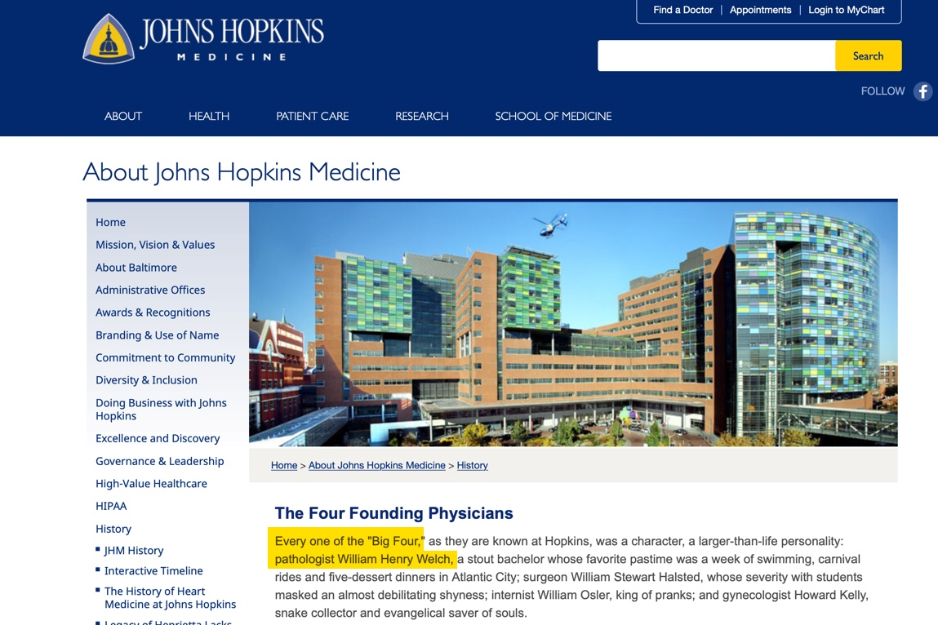

Slide 50
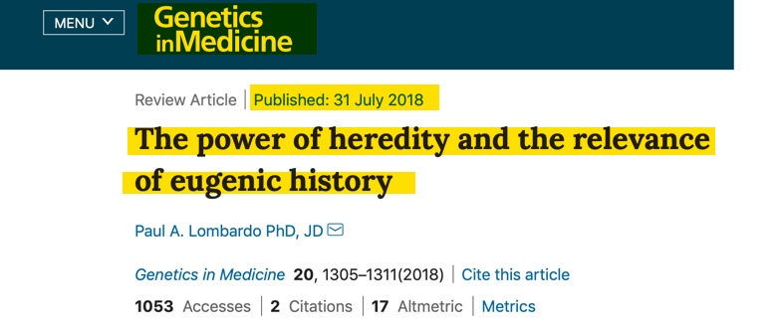
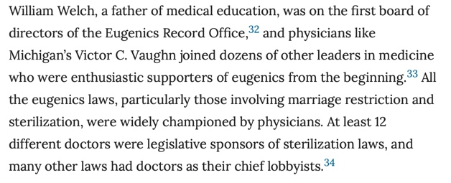

Slide 52
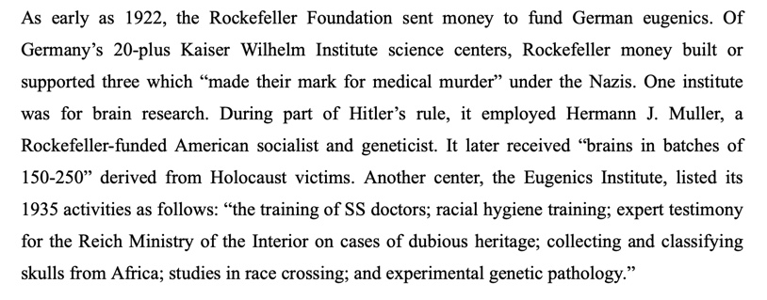

Slide 53
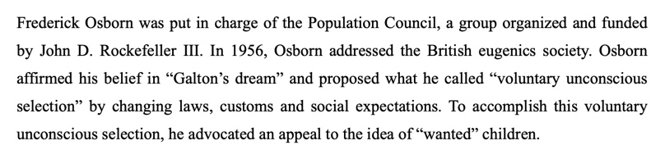

Slide 54
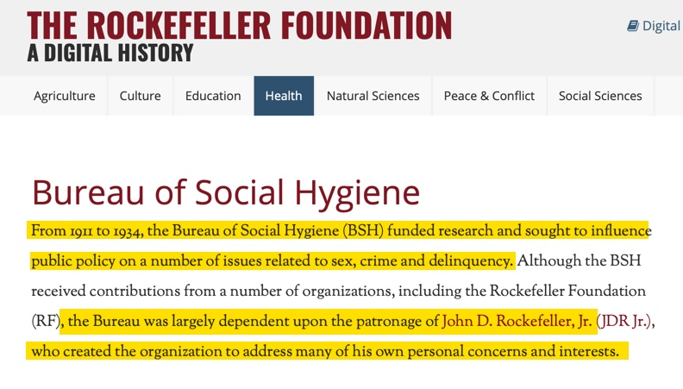

Slide 55


Slide 56
Dr. Dennis Cuddy:
1941: (fall): The resurgence of an international mental hygiene movement [eugenics] was foreshadowed by the Canadian army’s creation... of the Directorate of Personnel Selection, led by psychiatrist G. Rudin, G. Brock Chisholm, M.D.

Slide 57
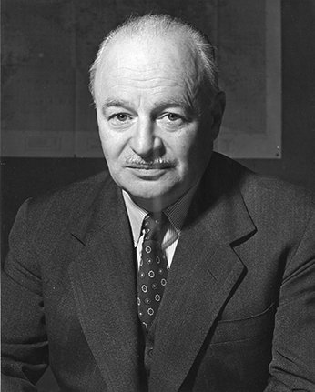
G. Brock Chisholm
Canadian Psychiatrist & Medical Practitioner
First Director General of
World Health Organization in 1948 &
1957 Became President of World Federation of Mental Health

Slide 58

London School of Economics
Became Part of University of London in 1900
London School of Hygiene and Tropical Medicine
Became Part of University of London in 1924

Slide 59
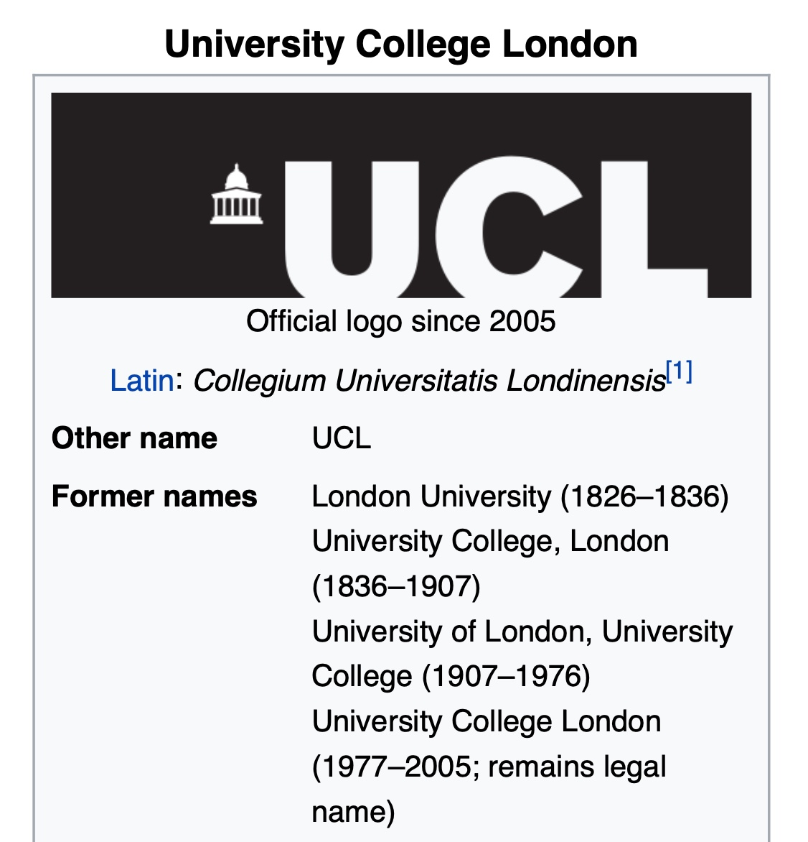

Slide 60
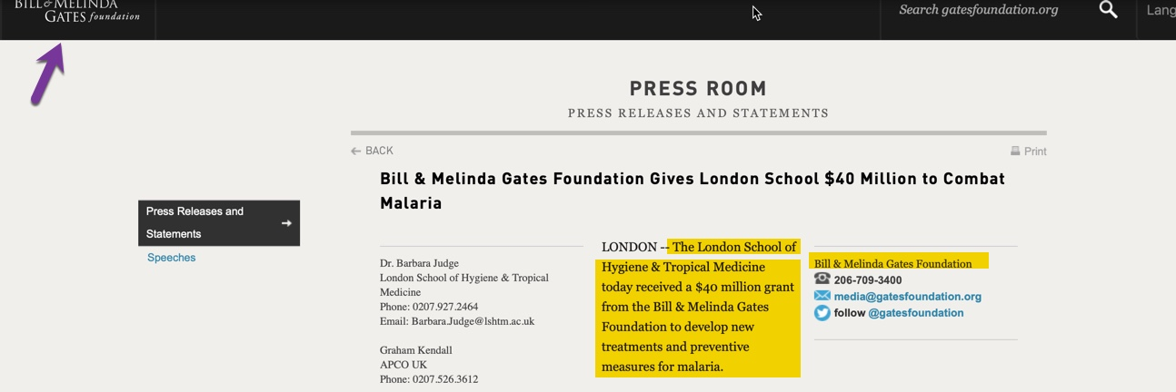

Slide 61
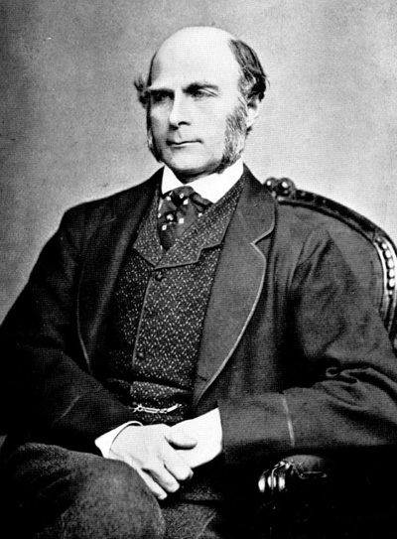
Francis Galton:
“Father of Eugenics”
Set up The Eugenics Records Office in 1904 at the University College of London
Cousin of Charles Darwin

Slide 63
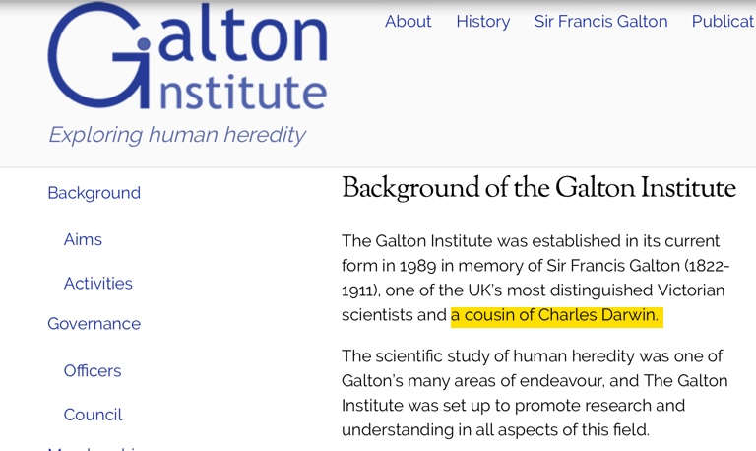

Slide 64


Slide 65
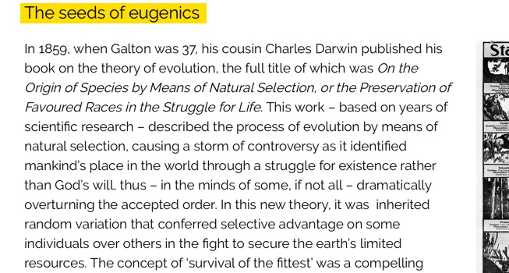

Slide 66


Slide 68


Slide 69
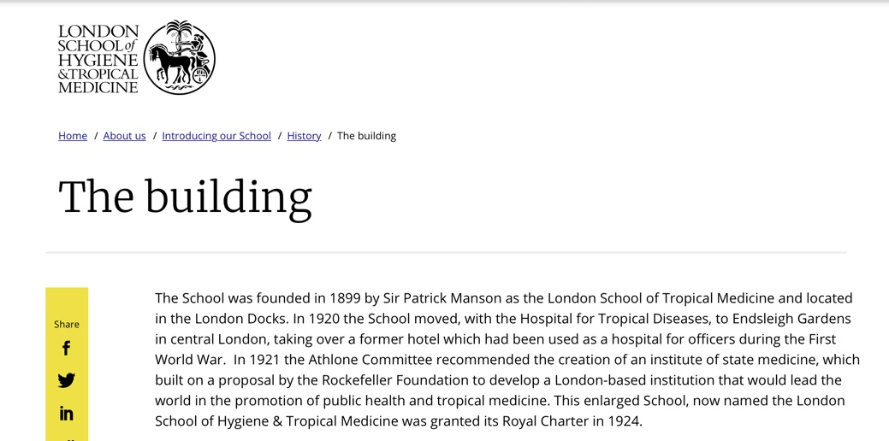

Slide 70
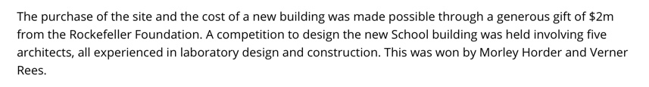

Slide 71
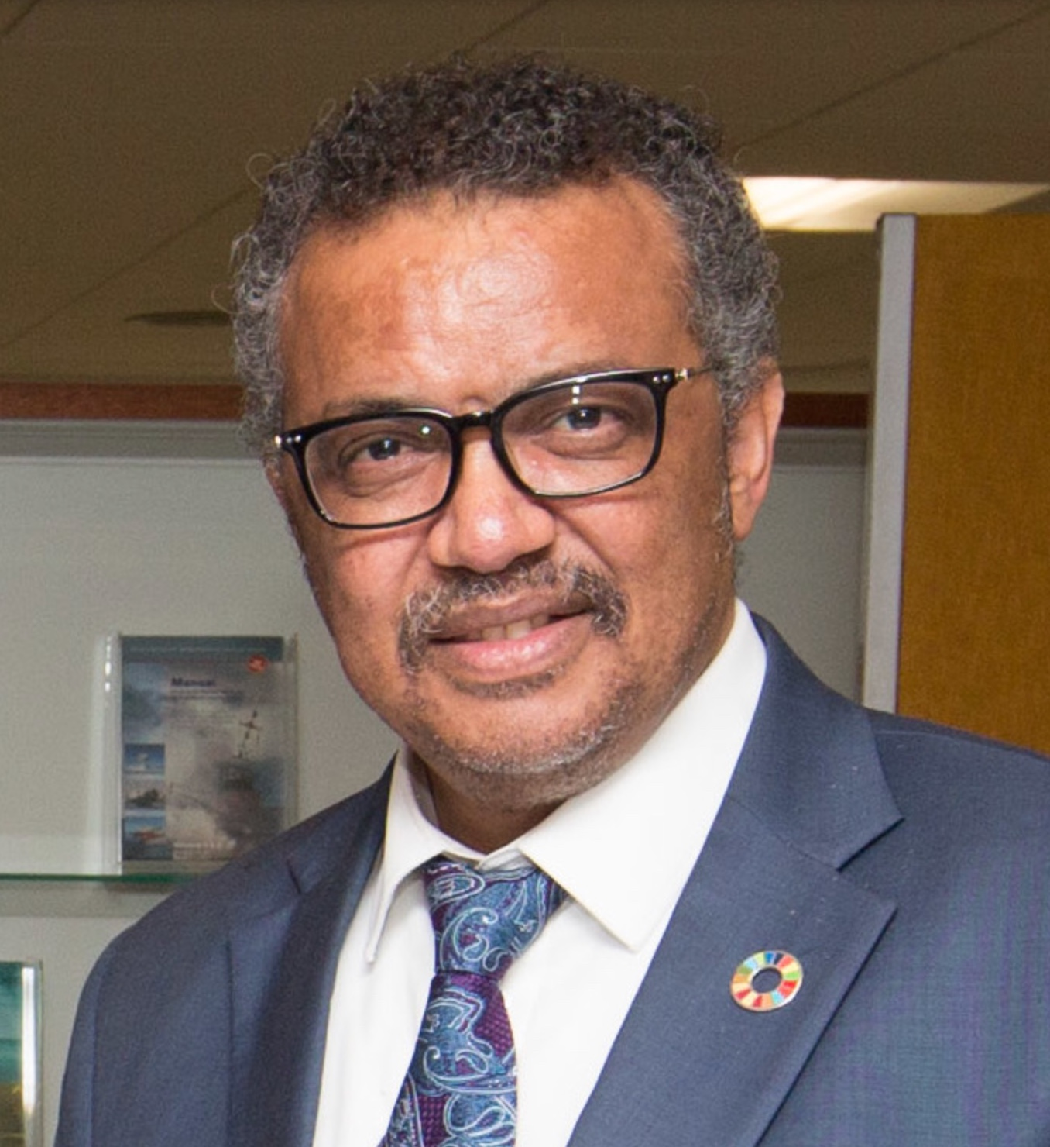
Dr. Tedros
Director-General of The World Health Organization

Slide 72


Slide 73
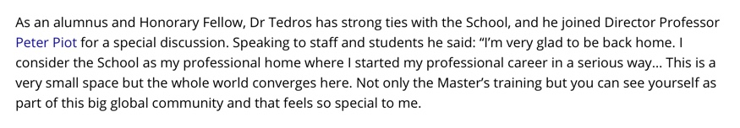

Slide 74
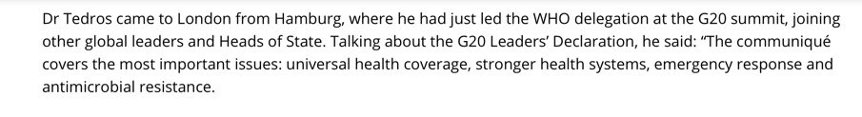

Slide 75
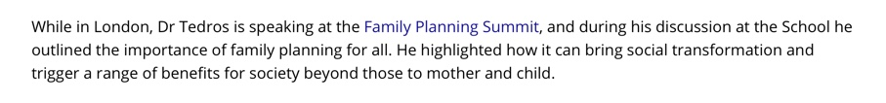

Slide 76


Slide 77
