Slide 1
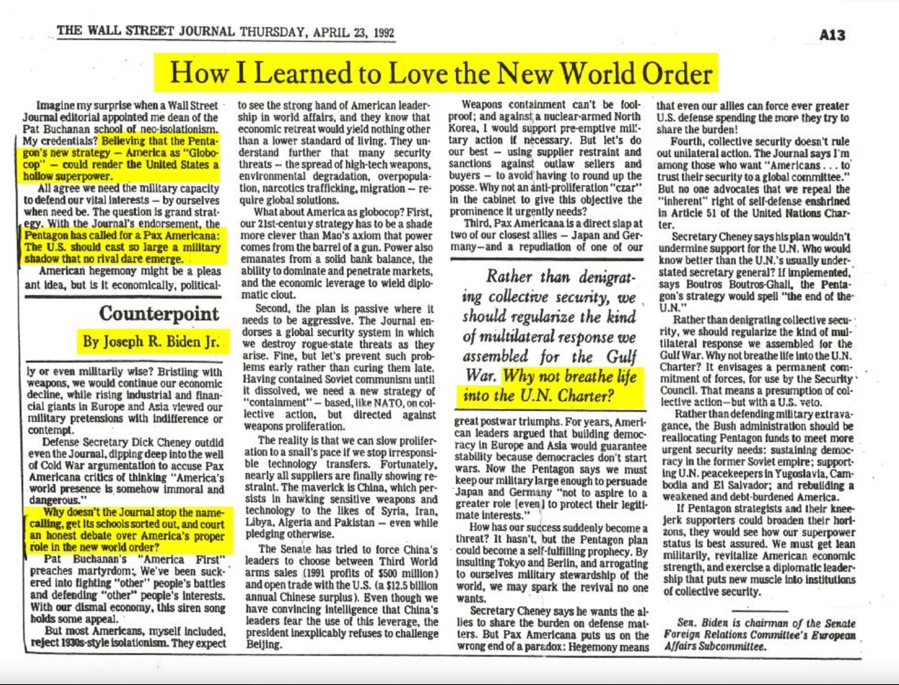

Slide 2
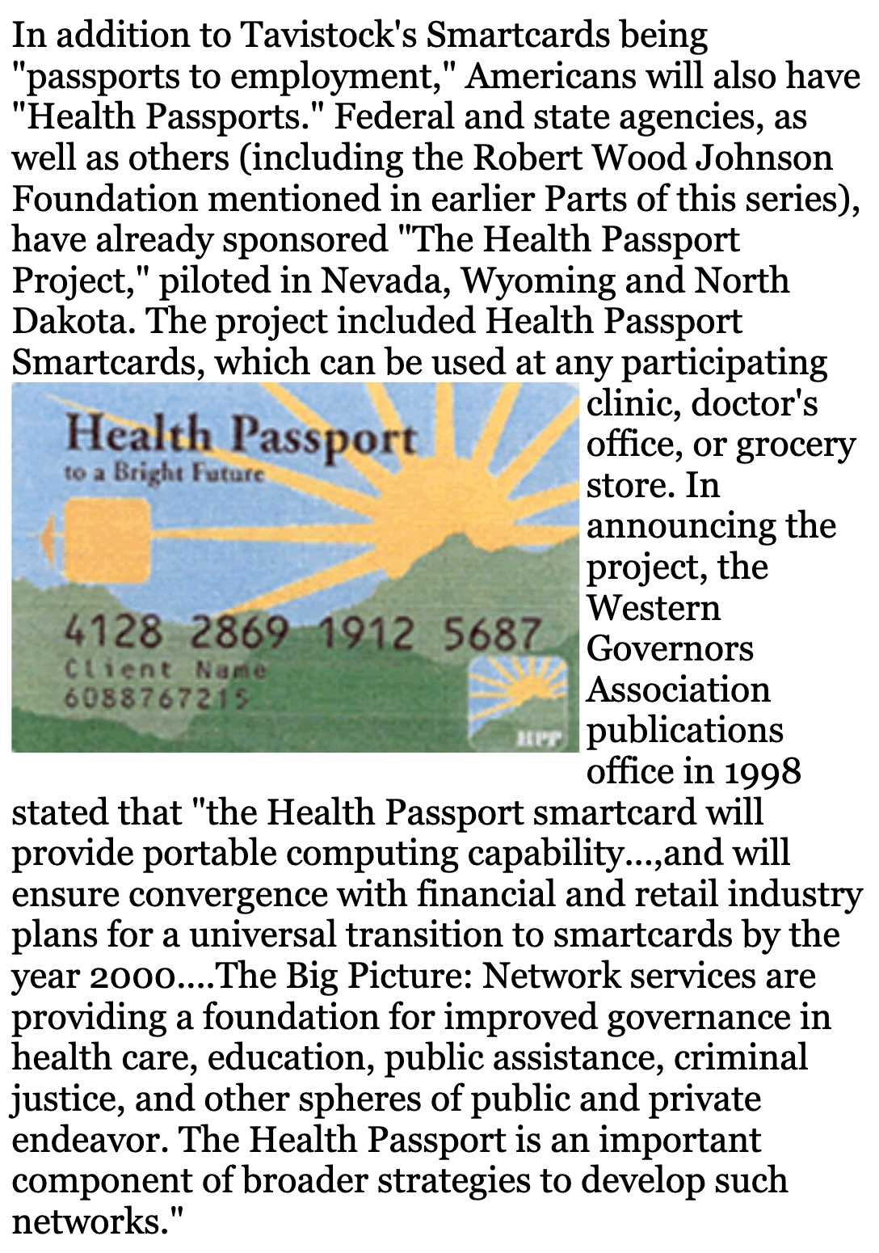

Slide 3
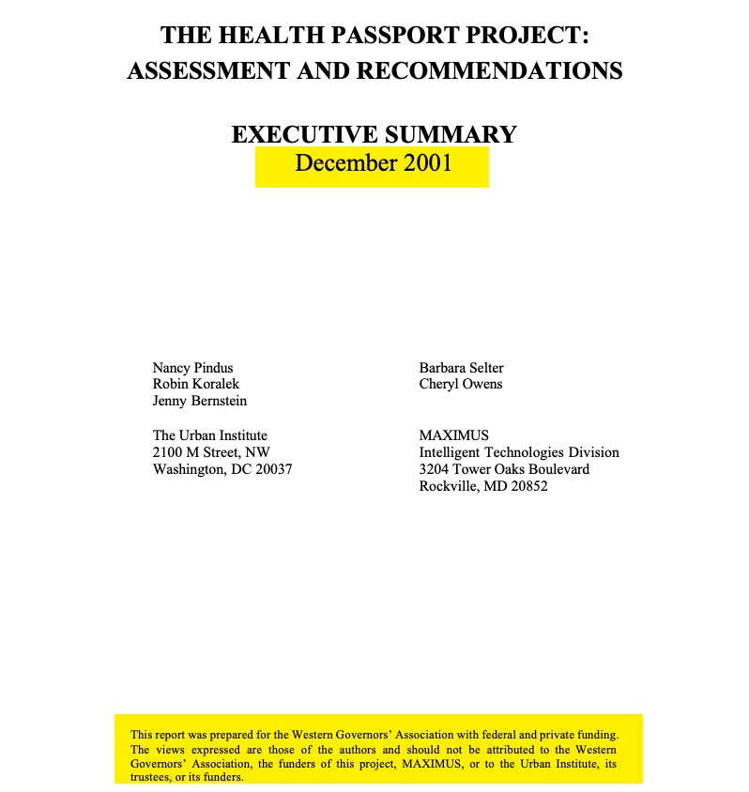
Source: https://www.urban.org/sites/default/files/publication/61741/410408-The-Health-Passport-Project-Assessment-and-Recommendations-Executive-Summary.PDF

Slide 4
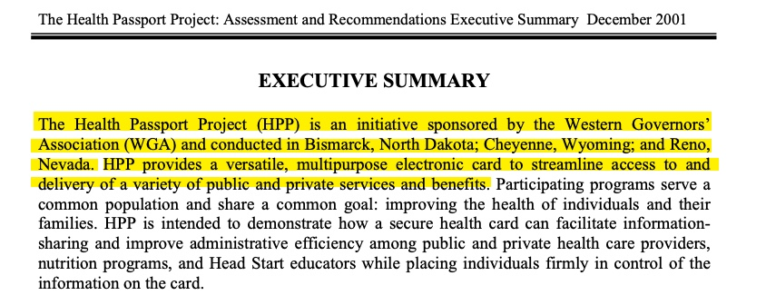
Source: https://www.urban.org/sites/default/files/publication/61741/410408-The-Health-Passport-Project-Assessment-and-Recommendations-Executive-Summary.PDF

Slide 5
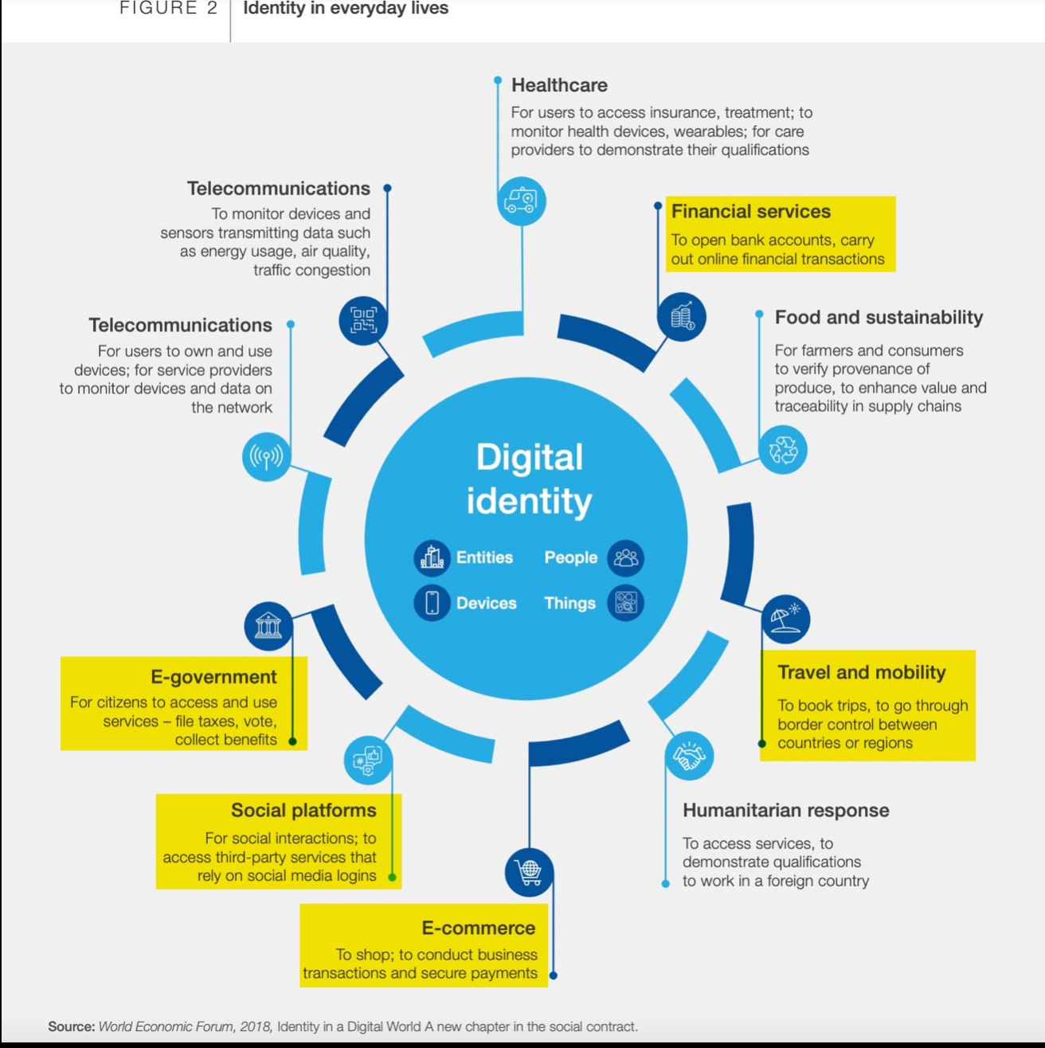

Slide 7
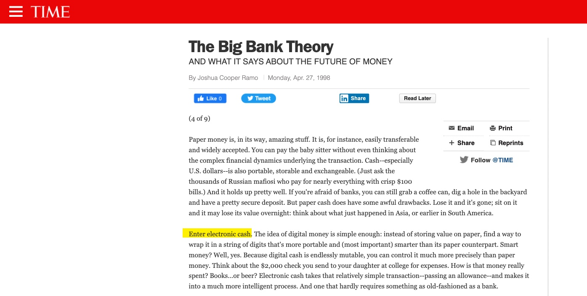

Slide 8
